Slide 1
DESIGN OF BRAKES -BY BODA RAJA K.HARSHA VARDHAN
COURSE COORDINATOR
-P.K.MOHANTY SIR

Slide 2
INTRODUCTION
Brakes are an essential component of any vehicle, responsible for slowing down or stopping it when needed. The design of brakes has evolved significantly over the years, with advancements in technology and materials.
The basic principle of a brake is to convert kinetic energy into heat energy through friction. This is achieved by applying pressure on a rotating disc or drum, which slows down the vehicle.

Slide 3
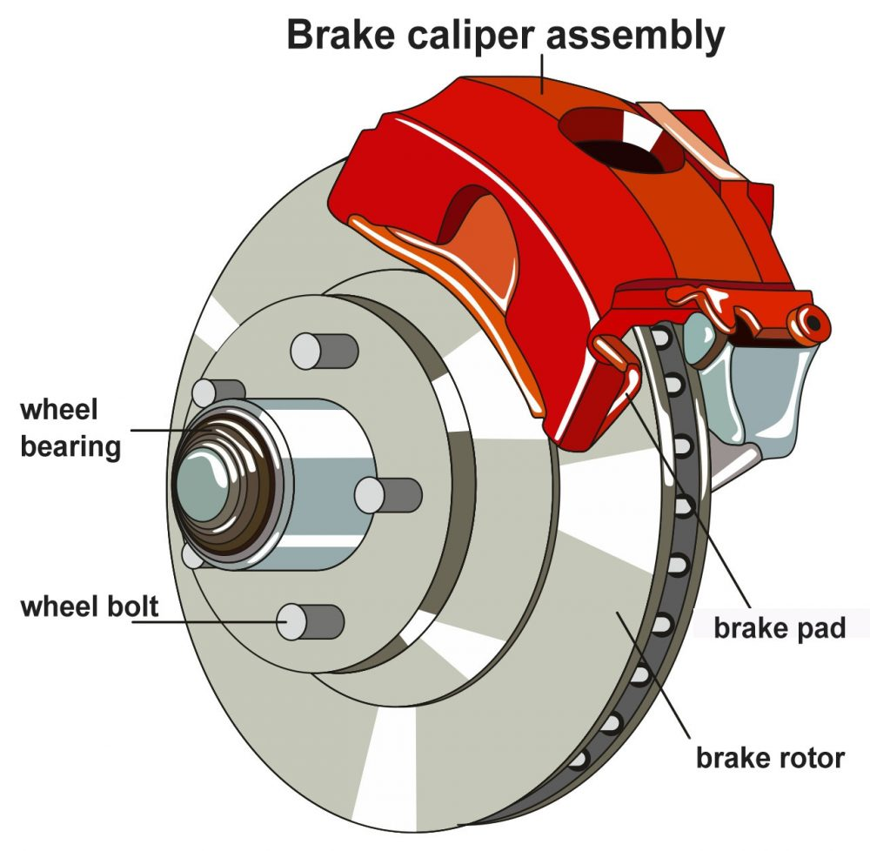
Fig-1:brake

Slide 4
DESIGN OF BRAKES
The design of brakes is a complex process that involves considering various factors such as the weight and speed of the vehicle, the type of material used for braking surfaces, and the type of brake system used. The brake system can be disc or drum brakes, and each has its advantages and disadvantages. Disc brakes provide better stopping power and are more efficient in dissipating heat, while drum brakes are less expensive and simpler to maintain

Slide 5
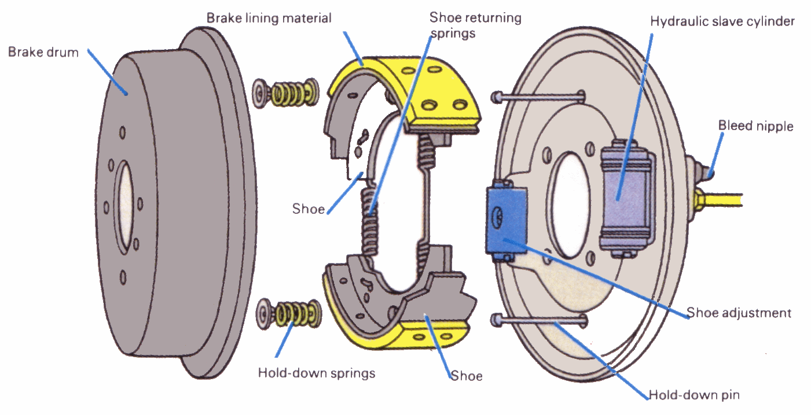
Fig-2:designing of brake

Slide 6
TYPES OF BRAKES
There are two main types of brakes - disc brakes and drum brakes. Disc brakes consist of a rotor and caliper, while drum brakes have a drum and shoes. Both types of brakes work on the same principle of friction, but disc brakes are more efficient due to their larger surface area.
Another type of brake that is gaining popularity is regenerative braking, which converts the kinetic energy of the vehicle into electrical energy to charge the battery. This is commonly found in hybrid and electric vehicle

Slide 7
DISC BRAKE
Disc brakes are a type of braking system used in vehicles that utilize a caliper(A caliper is part of the disc brake system) and brake rotor to slow or stop the vehicle. The caliper is mounted to the wheel hub and contains a set of brake pads that are pressed against the rotor when the brake pedal is applied.
The friction generated between the pads and the rotor slows down the vehicle. Disc brakes are known for their superior stopping power and ability to dissipate heat, making them ideal for high-performance vehicles.

Slide 8
DRUM BRAKE
Drum brakes are another type of braking system commonly used in vehicles. They consist of a brake drum, brake shoes, and a wheel cylinder. When the brake pedal is applied, the wheel cylinder pushes the brake shoes outwards, pressing them against the inside of the drum.
The friction generated between the shoes and the drum slows down the vehicle. Drum brakes are known for their durability and low cost, making them a popular choice for many vehicles.

Slide 9
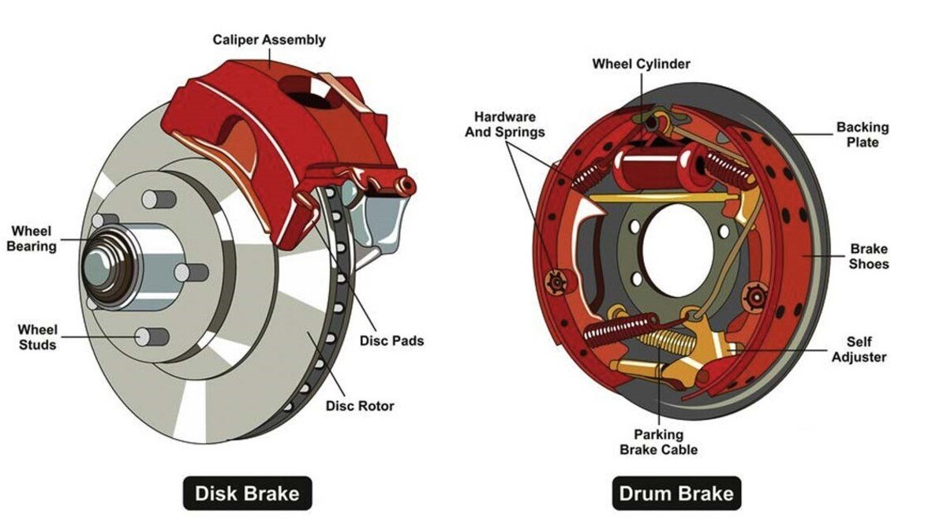
Fig-3:disc and drum brake

Slide 10
ADVANTAGES OF DISC AND DRUM BRAKES
Disc brakes have several advantages over other types of braking systems. They offer better stopping power, shorter stopping distances, and improved performance in wet conditions.
Drum brakes have several advantages over other types of braking systems. They are typically less expensive than disc brakes and are easier to service and maintain
Additionally, drum brakes are less to noise and vibration than disc brakes, which can be important for some drivers. They also tend to last longer than disc brakes, making them a good choice for vehicles that see a lot of heavy use.

Slide 11
FACTOR AFFECTING ON BRAKE PERFORMANCE
Several factors can affect the performance of brakes, including temperature, pressure, and wear. Brakes that are too hot or too cold may not function properly, while excessive pressure can cause them to lock up.
Wear is also a significant factor, as brake pads and rotors need to be replaced periodically. The frequency of replacement depends on various factors such as driving style, vehicle weight, and road conditions.

Slide 12
BRAKE SYSTEM MAINTAINANCE
Proper maintenance of the brake system is essential for its longevity and performance. Regular inspections and servicing can help identify any issues before they become major problems.
Some common maintenance tasks include checking the brake fluid level, replacing worn brake pads and rotors, and cleaning the brake calipers and pistons. It is also important to use the correct type of brake fluid and to follow the manufacturer's recommendations for maintenance intervals.

Slide 13
CONCLUSION
In conclusion, designing brakes is a complex process that requires careful consideration of various factors, including materials, testing, and future advancements.
By staying at the forefront of brake technology, we can continue to improve safety and performance on the road, while also pushing the boundaries of what is possible in automotive engineering.

Slide 14

FORMULAS
The first step in the design of a mechanical brake is to determine the braking-torque capacity for the given application. The braking-torque depends upon the amount of energy absorbed by the brake. When a mechanical system of mass m moving with a velocity v1 is slowed down to the velocity v2 during the period of braking, the kinetic energy absorbed by the brake is given by
KE=$\frac{1}{2}m{(V}_{1}^{2}−V_{2}^{2})$
Similarly, the kinetic energy of the rotating body is given by
KE=i($ω_{1}^{2}−ω_{2}^{2})$
or
KE=$\frac{1}{2}mk^{2}(ω_{1}^{2}−ω_{2}^{2})$

Slide 15

where,
I = mass moment of inertia of the rotating body (kg-m2)
k = radius of gyration of the body (m)
w1, w2 = initial and final angular velocities of the body
(rad/s)
In certain applications like hoists, the brake absorbs the potential energy released by the moving weight during the braking period
PE=mgh
Depending upon the type of application, the total energy absorbed by the brake is determined by adding the respective quantities .This energy is equated to the work done by the brake. Therefore,
E = $M_{t}θ$
where,
E = total energy absorbed by the brake (J)
Mt = braking-torque (N-m)
q = angle through which the brake drum rotates during the braking period (rad

Slide 16
THANK YOU

